Slide 1
Hologic Travel Program Update
Pre-Trip Auditor - New Travel Authorization Process
Travel Authorizer Overview
Effective Date: January 1, 2013

Slide 2

Approving Managers’ Role & Responsibility
When an out-of-policy reservation is made, you will receive an email advising that an out-of-policy travel booking requires attention.
1 | Your temporary password and User ID will be emailed to you when the first travel itinerary requiring approval is booked.
2 | Each time an out-of-policy booking is made, you will receive an email notification.
3 | To review the booking, select the link in the email and log-in to the URL.
4 | Review the itinerary details and select Approve/ Decline/ In Process.* You may add comments, which will be forwarded to the traveler.
* If a request is not actioned within the company-defined timeline, it may automatically be escalated to a backup authorizer.
Selecting “In Process” stops the escalation process
Even if escalated, you can still approve or decline your request.
Note: American Express is not responsible for lost fares due to delays in approval. Best practice is to approve or decline travel within 6 hours.

Slide 3
Initiating User ID and Password Setup
Your company has provided your name and email address, as well as a list of employees you are authorized to approve for travel.
The first time you receive an email to review a travel request, you will automatically receive your User ID and password in two separate emails.
Email 1: First travel authorization request |  | Email 2: User ID | Email 3: Temporary Password
Click on the link to access the application. When the page is displayed, enter your temporary User ID and Password, and click Continue.
Enter your first and last name, your permanent User ID, followed by the password of your choice.
This is a one time setup process:
Once your setup has been completed, the travel request will be displayed.

Slide 4
Travel Authorization Email for both Desktop and Mobile Devices
Below is an example of the Travel Authorization Email. Action is required when you receive this message.
Fast links to Approve, Decline, or Mark in Process
Fast link for Mobile Users to Approve, Decline, or Mark in Process
Itinerary information
Listed reasons, purpose of travel and traveller's comments approval is required
Link to full itinerary details

Slide 5
Accessing Travel Requests via Handheld Devices
Blackberry | Browser Configuration Settings Open the internet browser Hit jog dial or pearl and “Select Options” Go into the Browser Configuration Check boxes for “Support Java Script” AND “Use Cascading Style Sheets” If you have more than one Internet provider, follow steps 1-4 for each Cache Settings Repeat steps 1 and 2 above, if no longer in “Select Options” screen Go to “Cache operations” Select “clear” AND the setting ”keep clear”
Palm Treo | Cache Settings Open the internet browser Select the "Blazer" tab at the top left corner of the screen Go to "Options", then select "Preferences" Go to the "Advanced" tab Enter zero under "Set memory limit for storing pages:" Check the box labeled "Clear cache on exit". If you have more than one Internet provider, follow steps 1-6 for each
Windows Mobile PC | There are no specific changes for Mobile PC Users, but if you experience any of the symptoms outlined under Troubleshooting, use the following steps to clear the device’s cache. Open the internet browser choose “Menu”, “Tools”, and then “Options” Go to the “Memory” tab Select “Clear History” and “Delete Files
Your handheld settings must be updated to ensure visibility and accuracy of information.
Be sure to follow these steps prior to attempting to approve using your device:

Slide 6
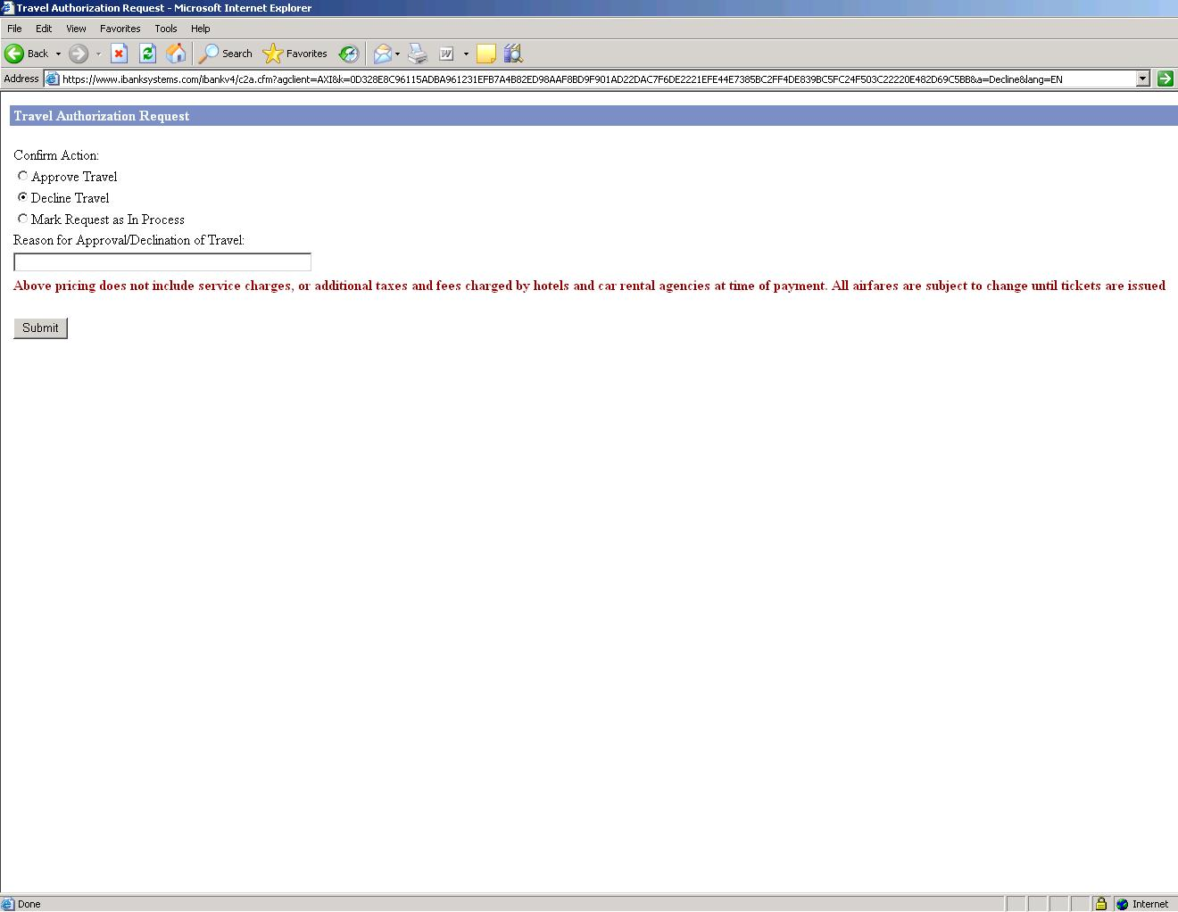
Authorizing Travel from the Authorization Email (on your mobile device)
By clicking the link, a pop-up selection will appear.
  Select action.
  Enter comments.
  Submit.
Total cost exceeds budget – please rebook.
Note: New users are first required to confirm a user ID and password. Subsequent requests can be processed from the fast links.

Slide 7
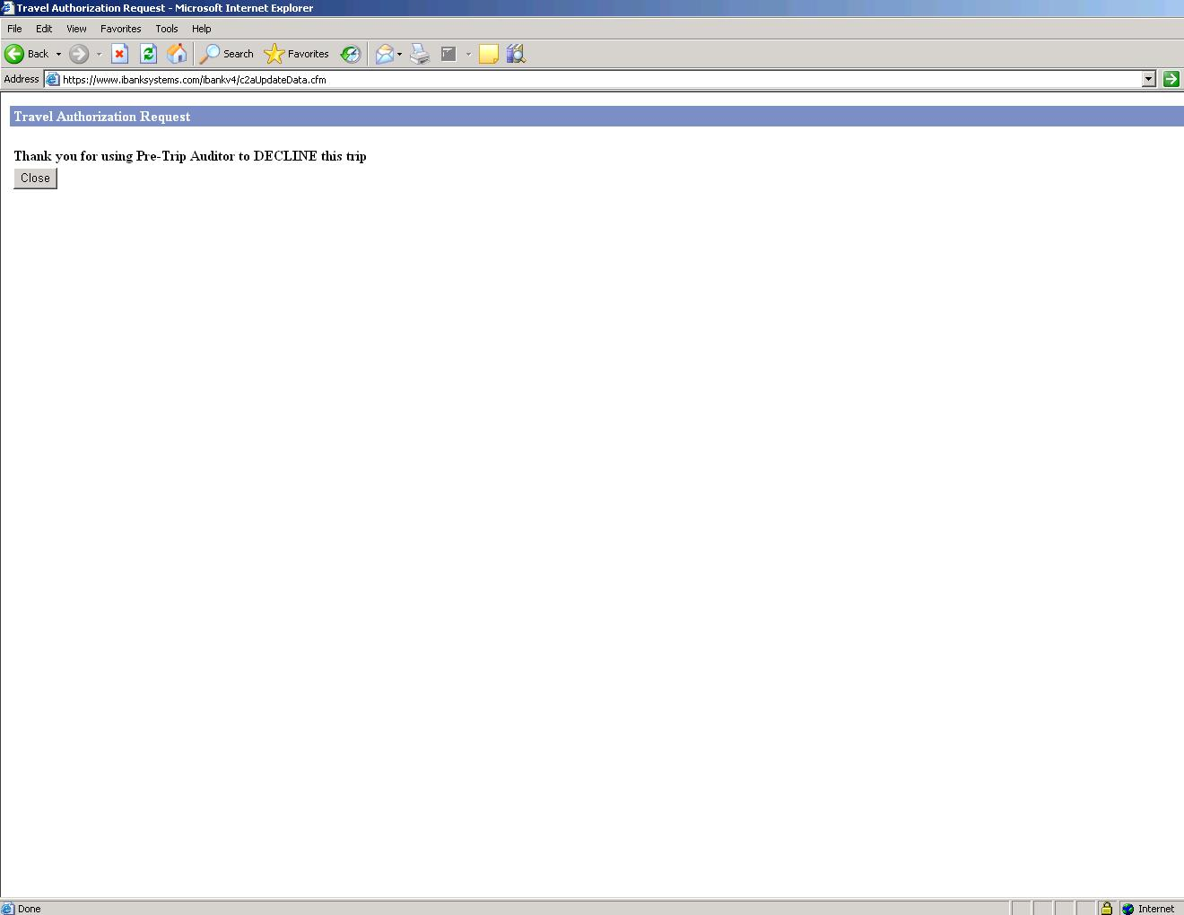
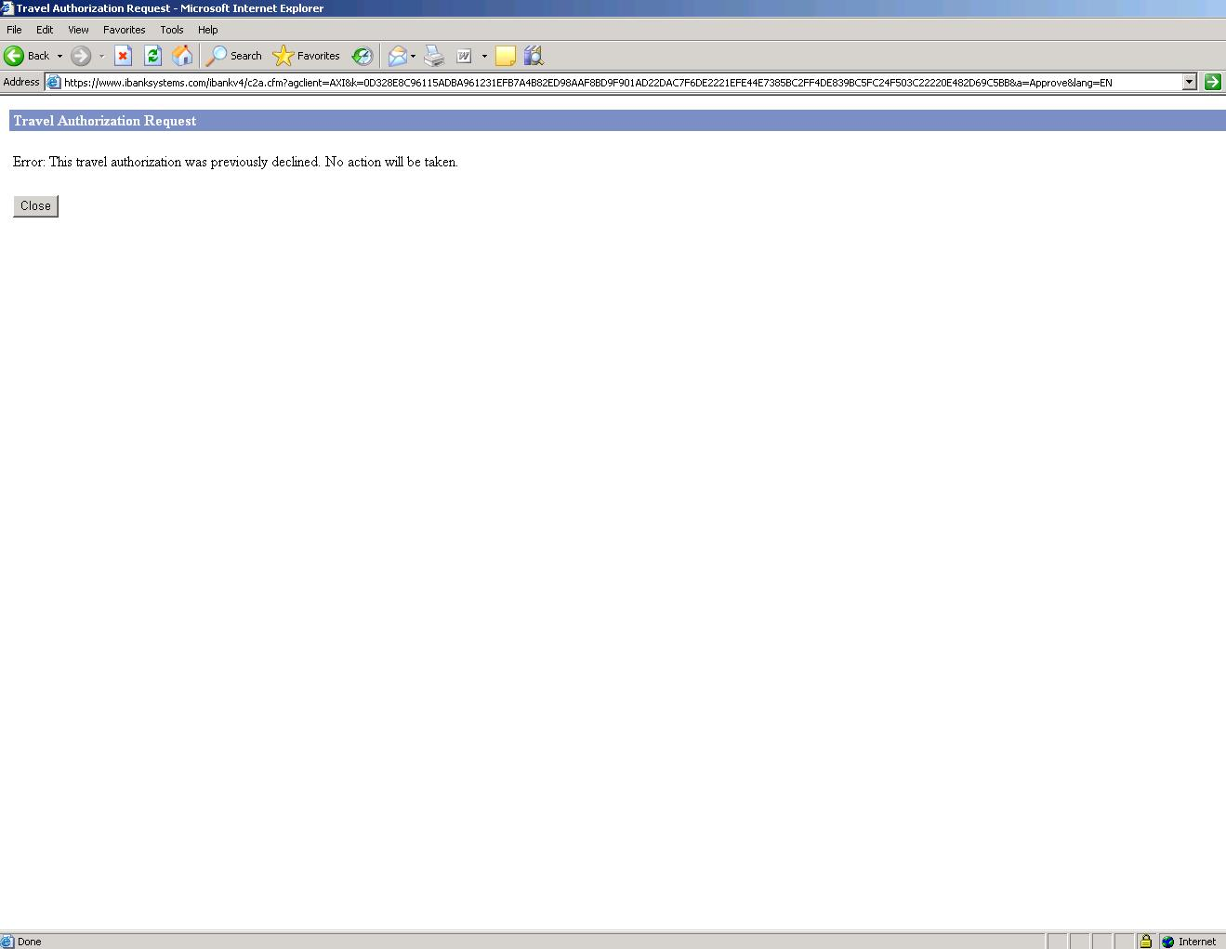
Confirming Status
AX Data Security requires confirmation of the action taken – with pop-up and follow-up email.
Travel requests already actioned will receive an Error message.

Slide 8
Troubleshooting Handhelds
As with many web-based applications accessed via Handheld Devices, there can be inherent issues with system caching, which is the refreshing of the site data presented to the user at login.
Tip: As a standard practice when using mobile devices, the cache settings should be cleared on a regular basis.
Symptoms:
  Error Message when attempting to access the website
  User sees previously actioned requests on trip list as pending or missing new requests
Quick Fix: Click the “Refresh” option in the devices browser. This forces the device to clear the cache and display the most current version of the web page. If this doesn’t work, clear the cache as outlined in Access via Handheld Devices.
Resolution: Validate all settings are correct, as defined in Access via Handheld Devices.
Symptom: Unable to Access Site Using URL on Email
Quick Fix: The quick resolution is to Copy the URL and paste it into the browser
Resolution: The cause of this problem could be the default browser, if more than one browser is available on the system. Go into the handheld’s Browser Configuration settings and ensure that the default browser is set to “internet browser”.

Slide 9
Authorizing Travel through the Website
A link in the email brings you to the main page. Your User ID and Org ID will auto-populate; enter your password.
Type your Password then click Sign In.
Note: If you are accessing the site from the main URL – not from an email link – you will need to know your User ID and Org ID.

Slide 10
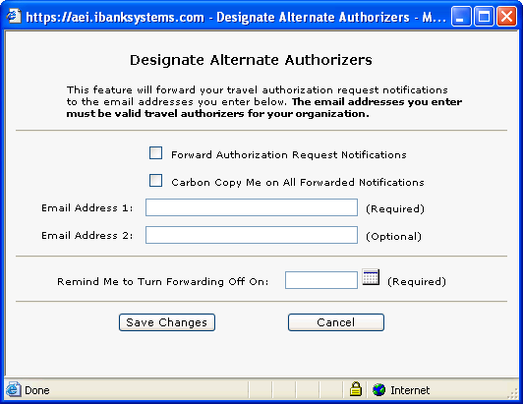
Delegation of Authority
When you are absent from your office or email, you can designate an alternate person to review travel requests.
Check box to forward authorizations, enter email address(es), and designate return date. You may also choose to be cc’d on notifications.
Note: in order to designate an alternate authorizer, the designee must already have a login and be associated with the same company as the designator.
Enter required details, and designate preferences

Slide 11
Changing User Settings and Designating an Alternate Approver
You can self-manage several aspects of the tool: reset your password, updated your email address, designate an alternate approver for when you are unavailable for an extended period of time.
1. Click on Administration.
3. Click Change User Password.
2. Choose User Settings.
Note: Changes to travelers in your hierarchy can only be completed by your Travel Manager and American Express Client Manager.
4. Click to designate an alternate approver

Slide 12
Processing a Travel Request
After logging-in, you will be taken to the Travel Authorization Request. The travel authorization is detailed in several sections.
Traveler and itinerary information
Scroll to the bottom for reason itinerary is out of policy and decision.

Slide 13
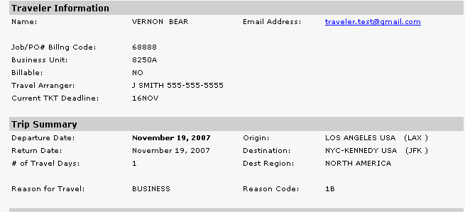
Processing a Travel Request (cont’)
The first two sections of the display shows the traveler's name, email address and other client specific information, along with a short trip summary.
Traveler name, email address, and client specific information.
Client specific information
Summary of the traveler's trip.

Slide 14
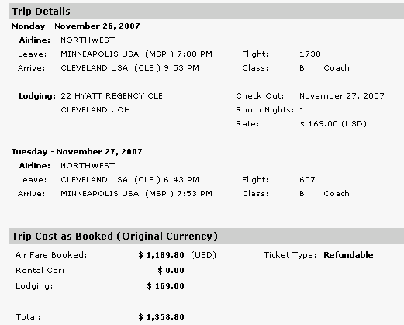
Processing a Travel Request (cont’d)
Scrolling down, you will see the Trip Details section, including flight information as well as car and hotel rental details, if applicable. You will also be able to see a cost breakdown of the trip.
This section contains the specific trip details including airline, car and hotel details.
Here is the cost of the trip broken down by air, car and hotel as well with a total cost.
This section contains the trip details regarding ticket type.

Slide 15
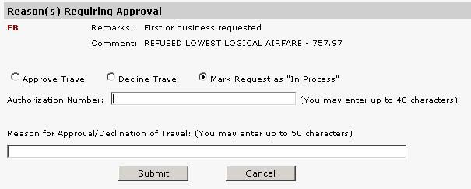
Processing a Travel Request (cont’d)
At the bottom of the display is the Reasons Requiring Approval section. This is where you will see why the trip has been sent for approval, and are provided the option to either approve or decline the trip. Select Approve, Decline, or In Process, and submit.
Select either the Approve Travel, Decline Travel or Mark Request as In Process.
Selecting ‘In Process’ changes the status until you Approve or Decline
(CAUTION: delays in approval raise risk of losing fares)
Document the reason the trip was approved or declined, as applicable. Comments are forwarded to the traveler.
Enter an Authorization Number, if applicable.
When you have completed this section, click the Submit button.

Slide 16
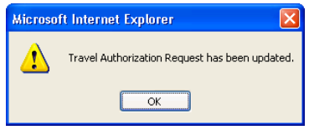
Processing a Travel Request (cont’d)
Once you have clicked the Submit button, you will see a confirmation message indicating the travel authorization request has been updated and recorded in the database.
Click the OK button to continue.
No further other action is required on your part or the part of the traveler once a travel request has been approved.
Tickets will be issued automatically and the traveler will receive a separate email that contains their itinerary and invoice.
If the travel request was declined, it’s up to the traveller to modify the original request or book a new trip. Note: Any changed or new reservation will return through the same audit process.

Slide 17
Authorizer’s List View
After you have actioned the trip, you will automatically be taken to the List View, where all your open transactions can be accessed. To action another trip, double click on the applicable link.
Note: you will only have visibility to travel itineraries assigned to you.
Click on a name to view the trip.
Filtering options.

Slide 18
Authorizer’s List View (cont’d)
You can access the list view at any time without waiting for an email or an URL link by simply logging in to the iBank application and selecting “Services→Travel Authorizations” and “Authorize or Decline a Pending Travel Request”

Slide 19
Tips for Success
  Ensure travellers are familiar with your travel policy (located on InfoCenter)
  Action travel requests as soon as possible, to avoid losing fares.
  American Express travel counsellors have been trained on your company’s travel policy and will advise travellers whenever possible to book according to the policy.
  American Express travel counsellors will not accept verbal travel approvals.
  American Express is not responsible for lost fares: be sure you review and action travel requests promptly.
  Delays in approval may result in lost airfares or cancelled reservations (Airlines may cancel reservations that are NOT ticketed within 24 hours).
  Updates to your traveler group can only be made through your Travel Manager and American Express Client Manager.

