Slide 1
Hologic: The Science of Sure
New brand positioning
Corporate Marketing & Communications
16 September 2014

Slide 2
The Leader in Digital Imaging Systems
The Power of Now
We Are Women’s Health
Earlier, Smarter, Better
Clarity of Vision
Defining the Standard of Care in Women’s Health
A Family of Companies
Collectively Brilliant. Individually Strong
Defining the Standard of Care in Women’s Health
The Power of Women’s Health
The Women’s Health Company
The Power of One
Every Life is Extraordinary
Extraordinarily Powerful Care
Over the past 14 years Hologic has had over 14 different
brand lines — many still in use today.

Slide 3
Embraces our truth as a superior technology organization, not just a general ‘care’ company.
Celebrates the visionary approach that lives at our core. We apply the brand to everything we do.
Injects challenger passion into every corner of the brand/company.
Focuses on delivering the best diagnostics, detection and surgical technology to the world.
Galvanizes the energy, talent and passion of our colleagues.
Unifies everyone who works at Hologic and informs our work on a daily basis.
Why now?

Slide 4
Investors and employees can feel confident we’re a company with a sure-footed approach to its future. Every investor wants to be “sure”. Healthcare Professionals can be more sure in the diagnosis they provide to their patients and its likely outcomes. Purchasers can be confident in our machines, our support and the service we offer, and more certainty means more efficient healthcare delivery. Regulators can be more certain about healthcare provision. Patients can feel more secure in their diagnosis.
Stakeholder relevance?

Slide 5
Our new brand promise

Slide 6
Be sure.
In healthcare, that’s what matters.
So at Hologic we promise what we call progressive certainty — our commitment to helping healthcare professionals minimize doubt and maximize the confidence they have in the decisions and diagnoses they make.
With clearer images, simpler surgical procedures, more efficient diagnostic solutions and better results, the peace of mind we strive to achieve for our customers and their patients is inspired by science, supported by technology and reinforced by our passionate determination to improve outcomes.
We are unyielding, indomitable and never satisfied with the status quo.
Hologic: The Science of Sure in action.
Manifesto

Slide 7
Reflect our brand value proposition progressive certainty
Make it ownable
Keep it simple and clean
Timeless not trendy
Honors the past but embraces the future
Make sure it works everywhere
What does it look like?

Slide 8
Brand Essence video
NOTE: watch Brand Essence video

Slide 9
Our brand identity: bold, balanced and confident

Slide 10
Balance – be flexible while keeping intact the core principles and attributes that formed the brand
Richness – provides a more immersive, interactive holistic experience
Diverse – allows divisions to express their own way while maintaining consistency with established parameters
Dynamic – never boring, executional variance in a smart way, multitude of expressions for different media
Aligned – aligned with the challenger brand position, take leaps of faith, abandon self-obsessions and embrace risk
Fluid
Identity

Slide 11
Acceptable versions/main logo (usage min. 1.5”)

Slide 12
Acceptable versions/smaller applications (usage 1.5”-1”, min. 1”)

Slide 13
Acceptable versions/enclosed

Slide 14
Revealing

Slide 15
Real people

Slide 16
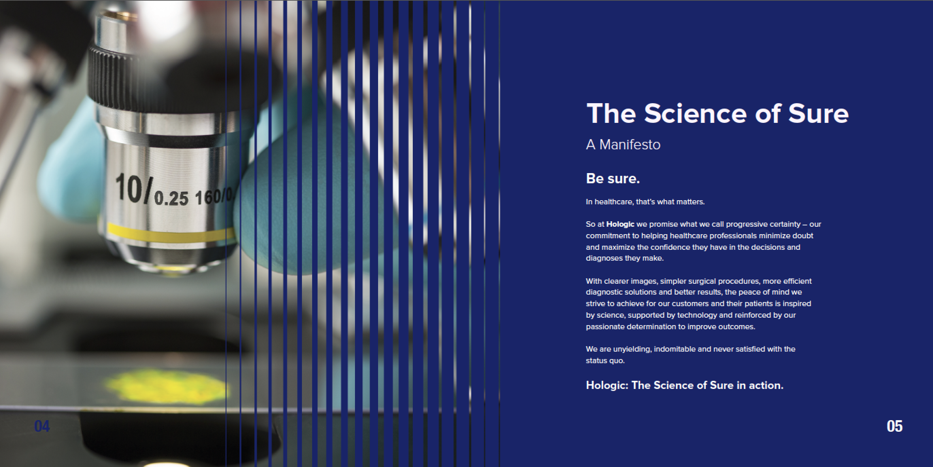
Clinical

Slide 17
Uncluttered

Slide 18
Focused

Slide 19
Confident

Slide 20
Thank you.

